Slide 1
A Case Study in Software Design - 3
Dane Hillard’s “Bark”
CIDM 6330

Slide 2
Inheritance and Composition
“Is a” and “Has a”
Ontological and Taxonomic
Abstract to Concrete Hierarchies
Super and Sub class (parent/child or base/derived)
Specialization and Specification

Slide 3
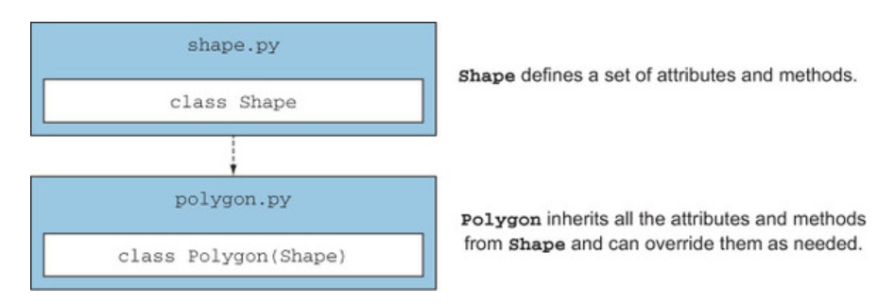
New Behaviors – Extensible via Specialization

Slide 4
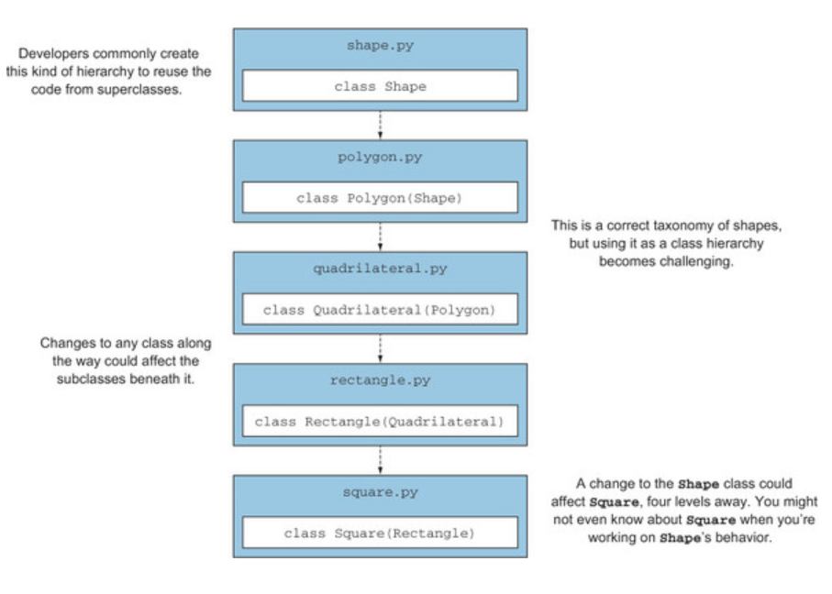
It gets messy

Slide 5
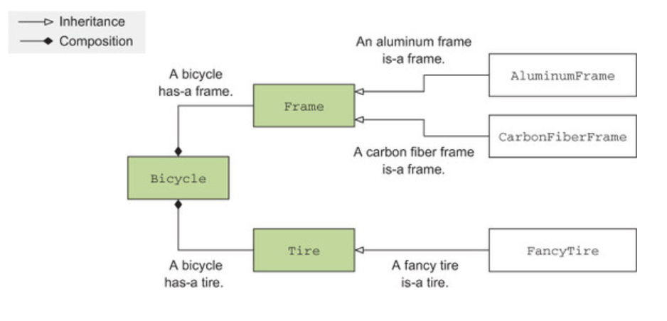
“Is a” and “Has a”

Slide 6
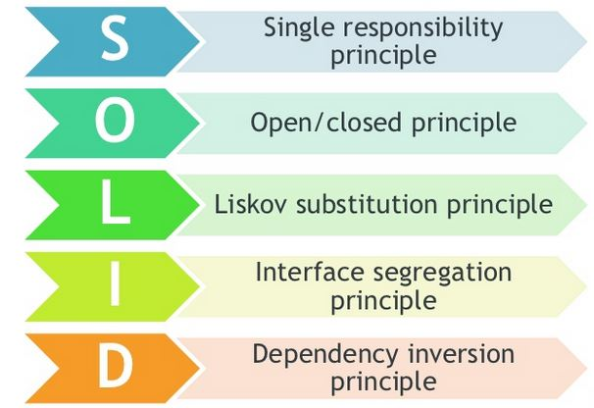
SOLID Principles

Slide 7
When Inheritance is Good
The problem you’re solving has a shallow, narrow hierarchy.
Subclasses are at the leaves of the object graph; they don’t make use of other objects.
Subclasses use (or specialize) all the behavior of their superclass.

Slide 8
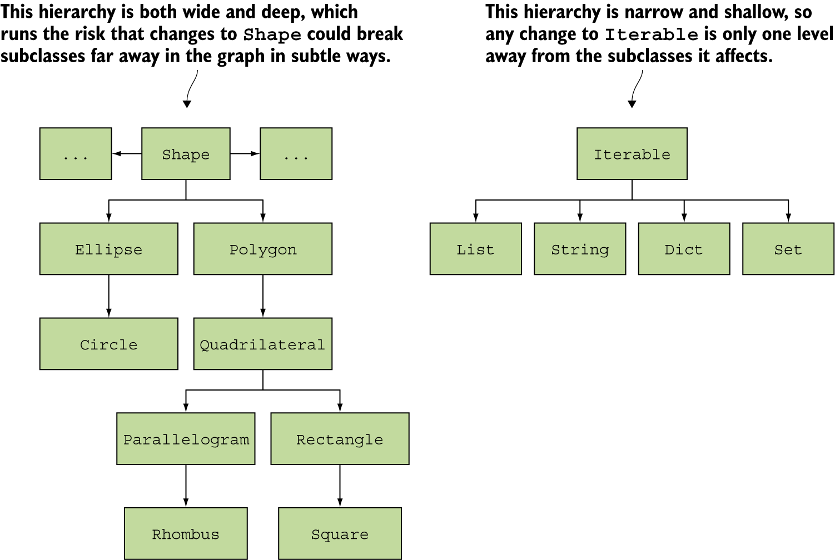
Examples

Slide 9
Python Tools for Inheritance
Type checking and hinting
The super keyword
*gasp* multiple inheritance (really?)
ABCs

Slide 10
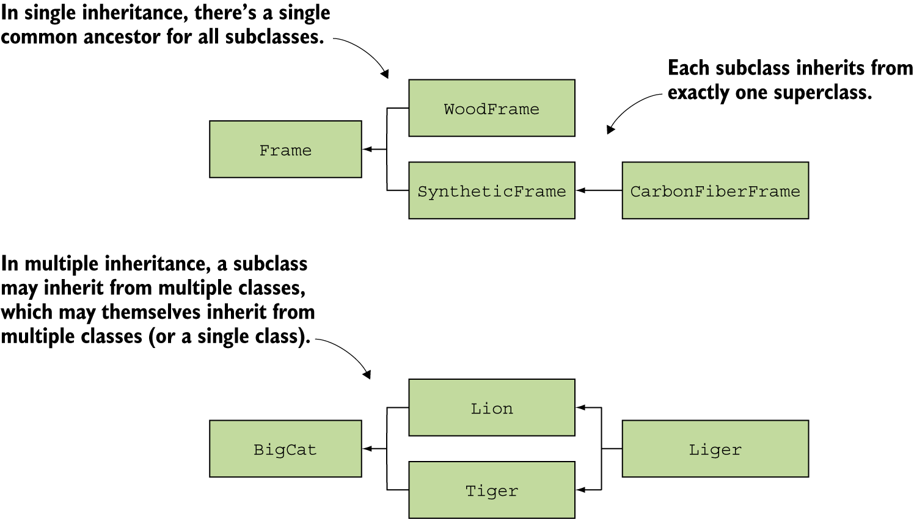
Sticky Wicket of Multiple Inheritance

Slide 11
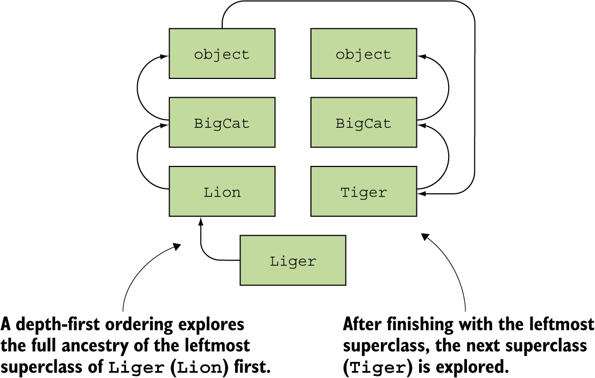
Multiple Inheritance Resolution Ordering

Slide 12
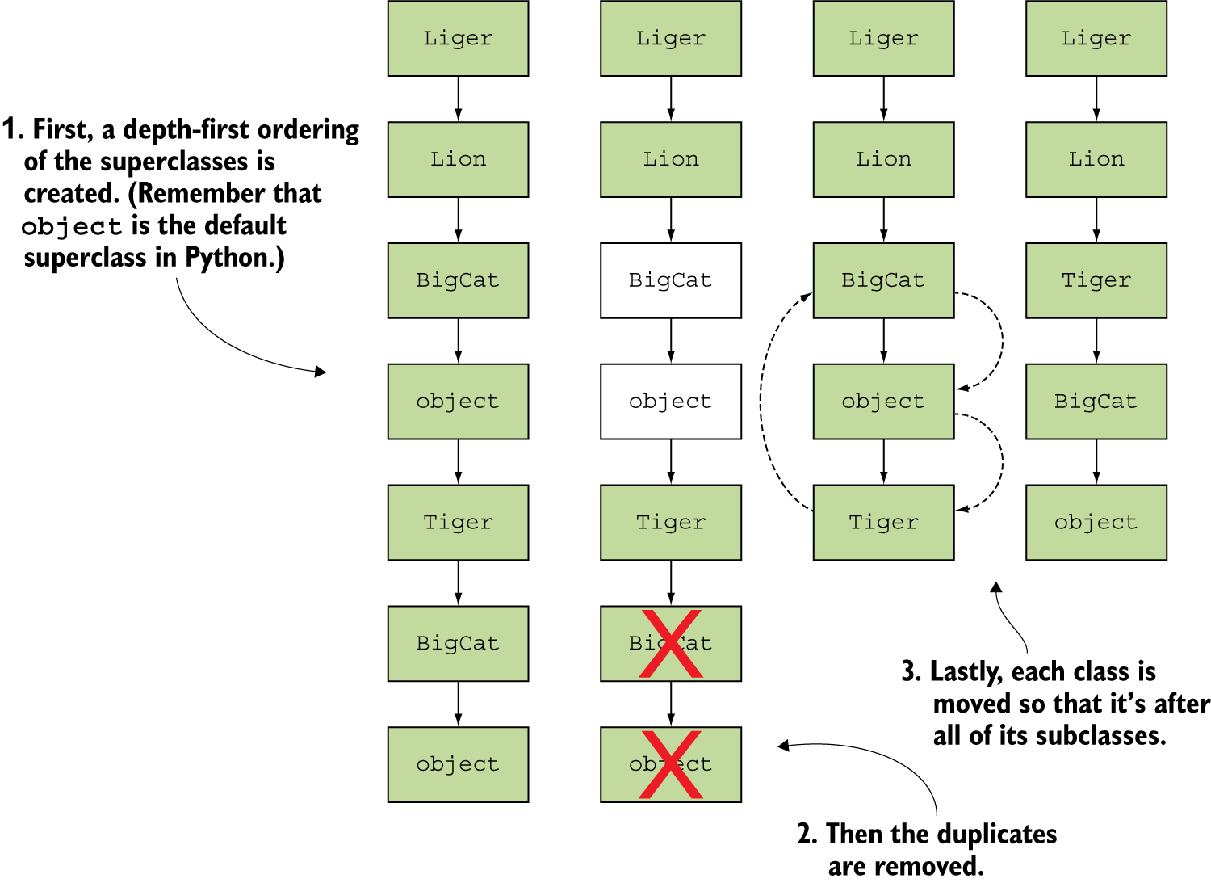
Multiple Inheritance is a mess

Slide 13
Refactor Barky
To Use ABCs

Slide 14
The Code

